Slide 1
Micro-Frontends
Lecturer: Ngo Huy Bien
Software Engineering Department
Faculty of Information Technology
VNUHCM - University of Science
Ho Chi Minh City, Vietnam
nhbien@fit.hcmus.edu.vn

Slide 2

Objectives

Slide 3

Contents

Slide 4

References
https://martinfowler.com/articles/micro-frontends.html
Michael Geers (2020). Micro Frontends in Action. Manning Publications.
Luca Mezzalira (2022). Building Micro-Frontends. O'Reilly Media.

Slide 5
Micro-Frontends [1]
An architectural style where independently deliverable frontend applications are composed into a greater whole.

Slide 6
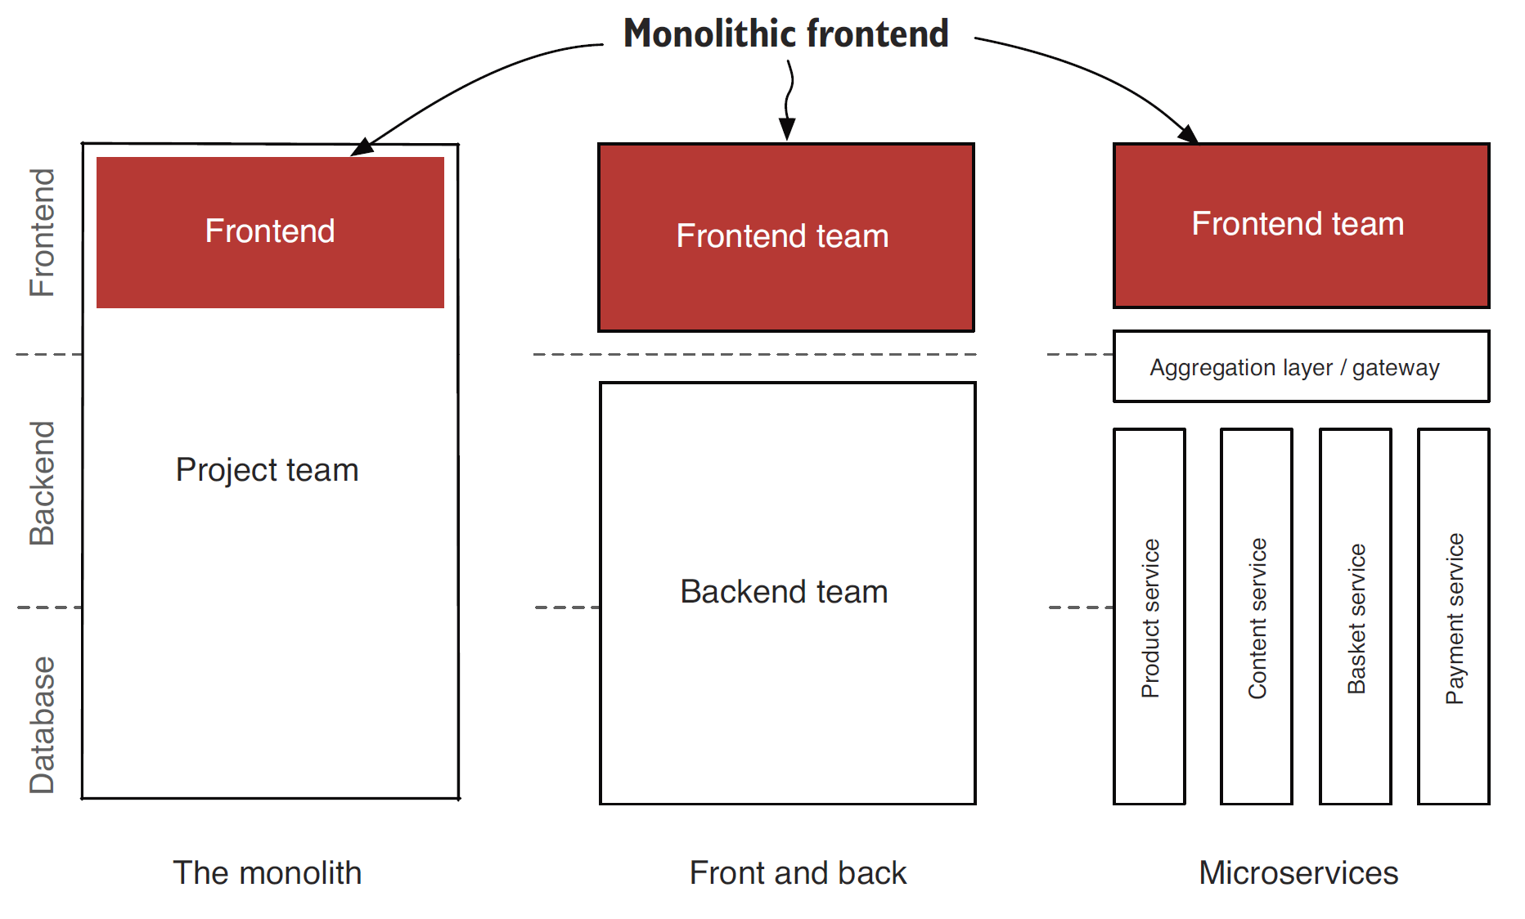
Monolithic Frontend [2]

Slide 7
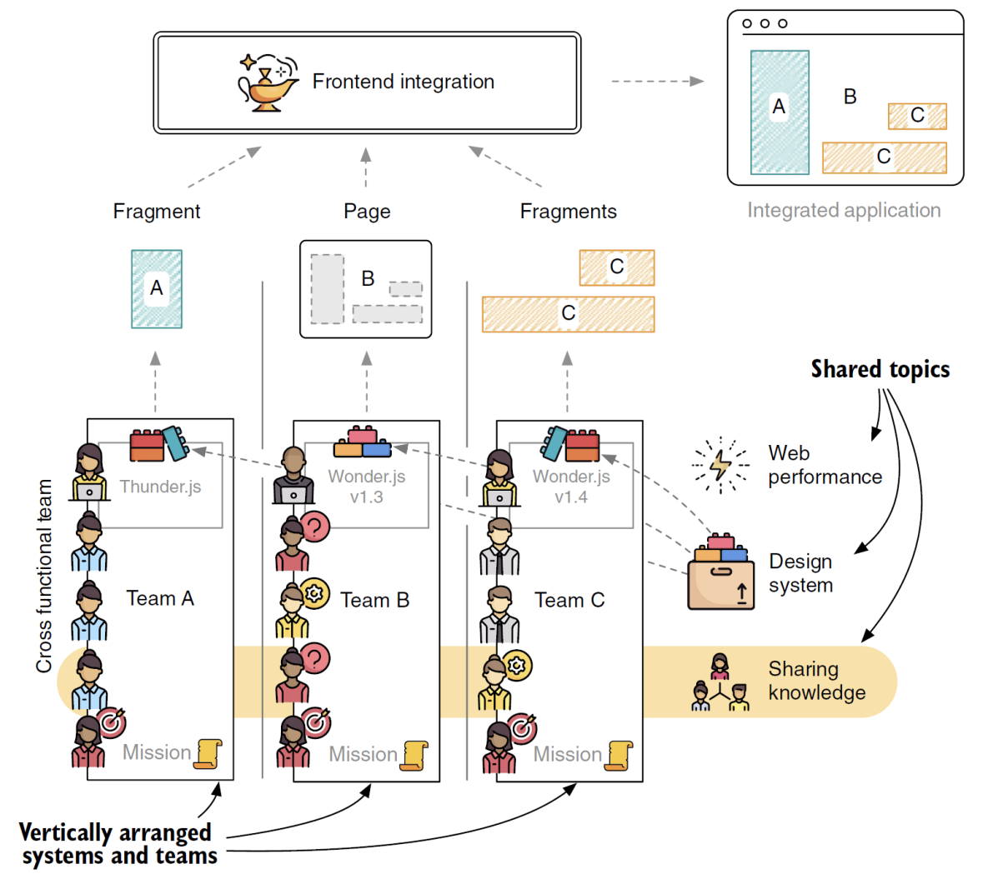
Decomposition

Slide 8
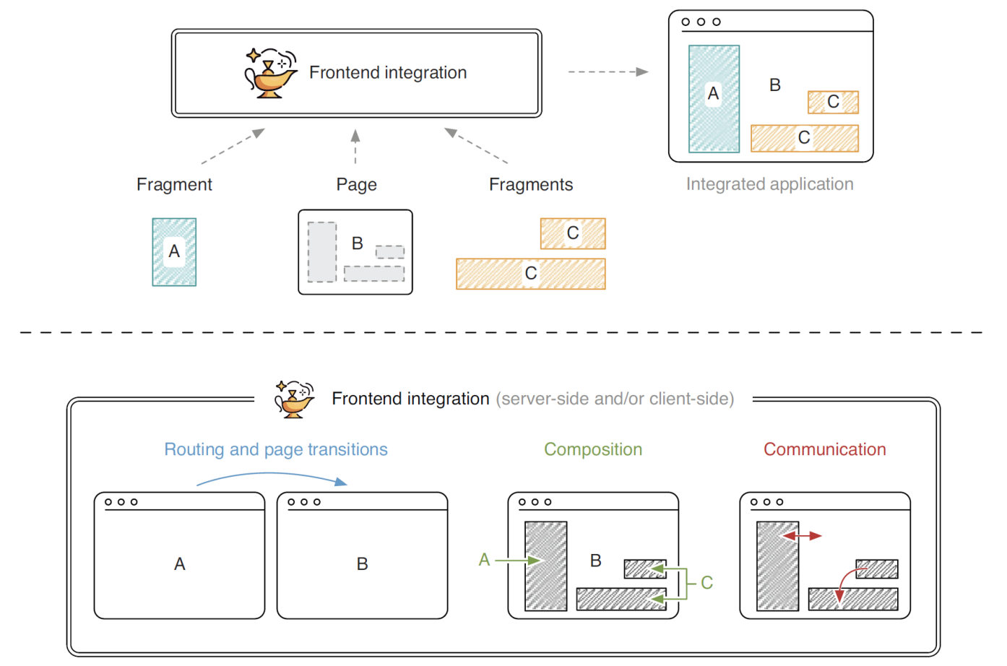
Integration

Slide 9
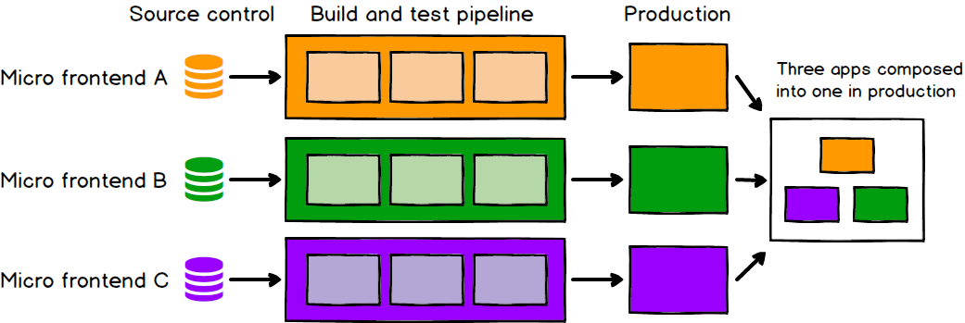
Why Micro-Frontends? [1]
Autonomous teams
Incremental upgrades
Simple, decoupled codebases
Independent deployment

Slide 10
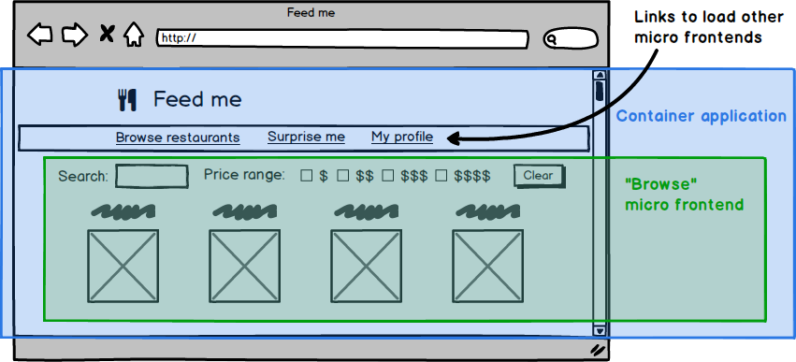
Decomposition approaches
Generally there is a micro frontend for each page in the application, and there is a single container application.

Slide 11
Integration approaches
there is a single container application, which:
renders common page elements such as headers and footers
addresses cross-cutting concerns like authentication and navigation
brings the various micro frontends together onto the page, and tells each micro frontend when and where to render itself

Slide 12
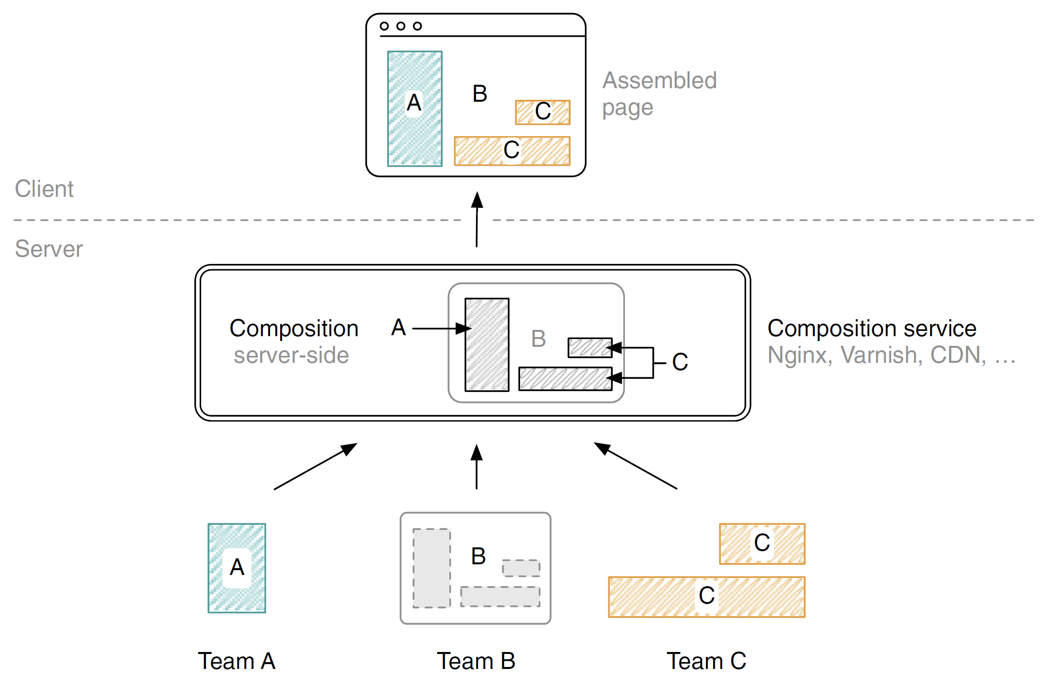
Server-side Composition [2]

Slide 13
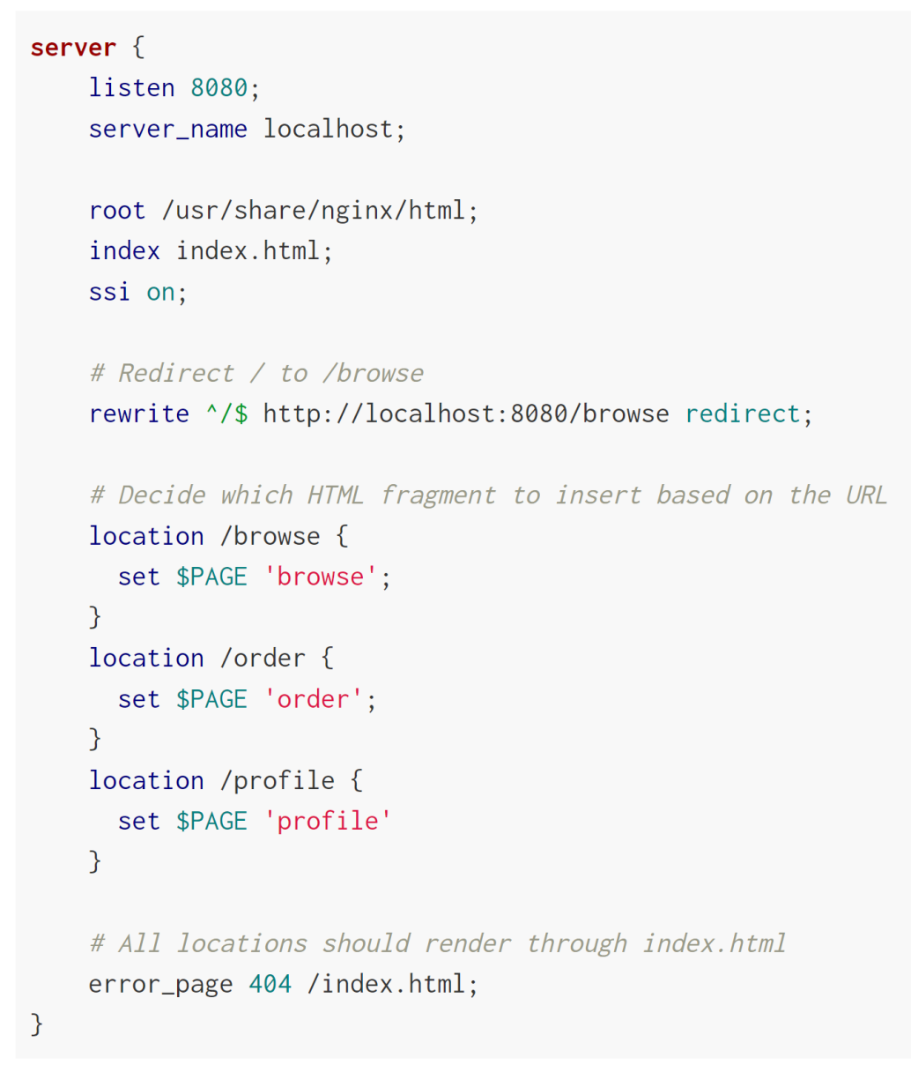
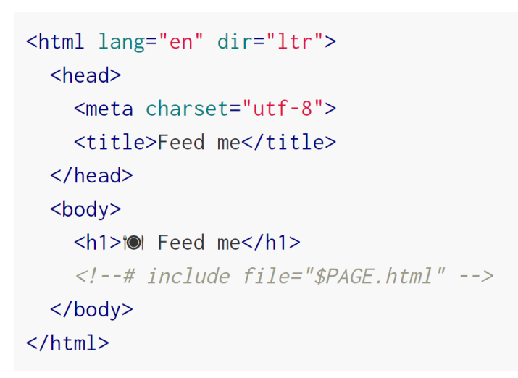
Server-side template integration [1]

Slide 14
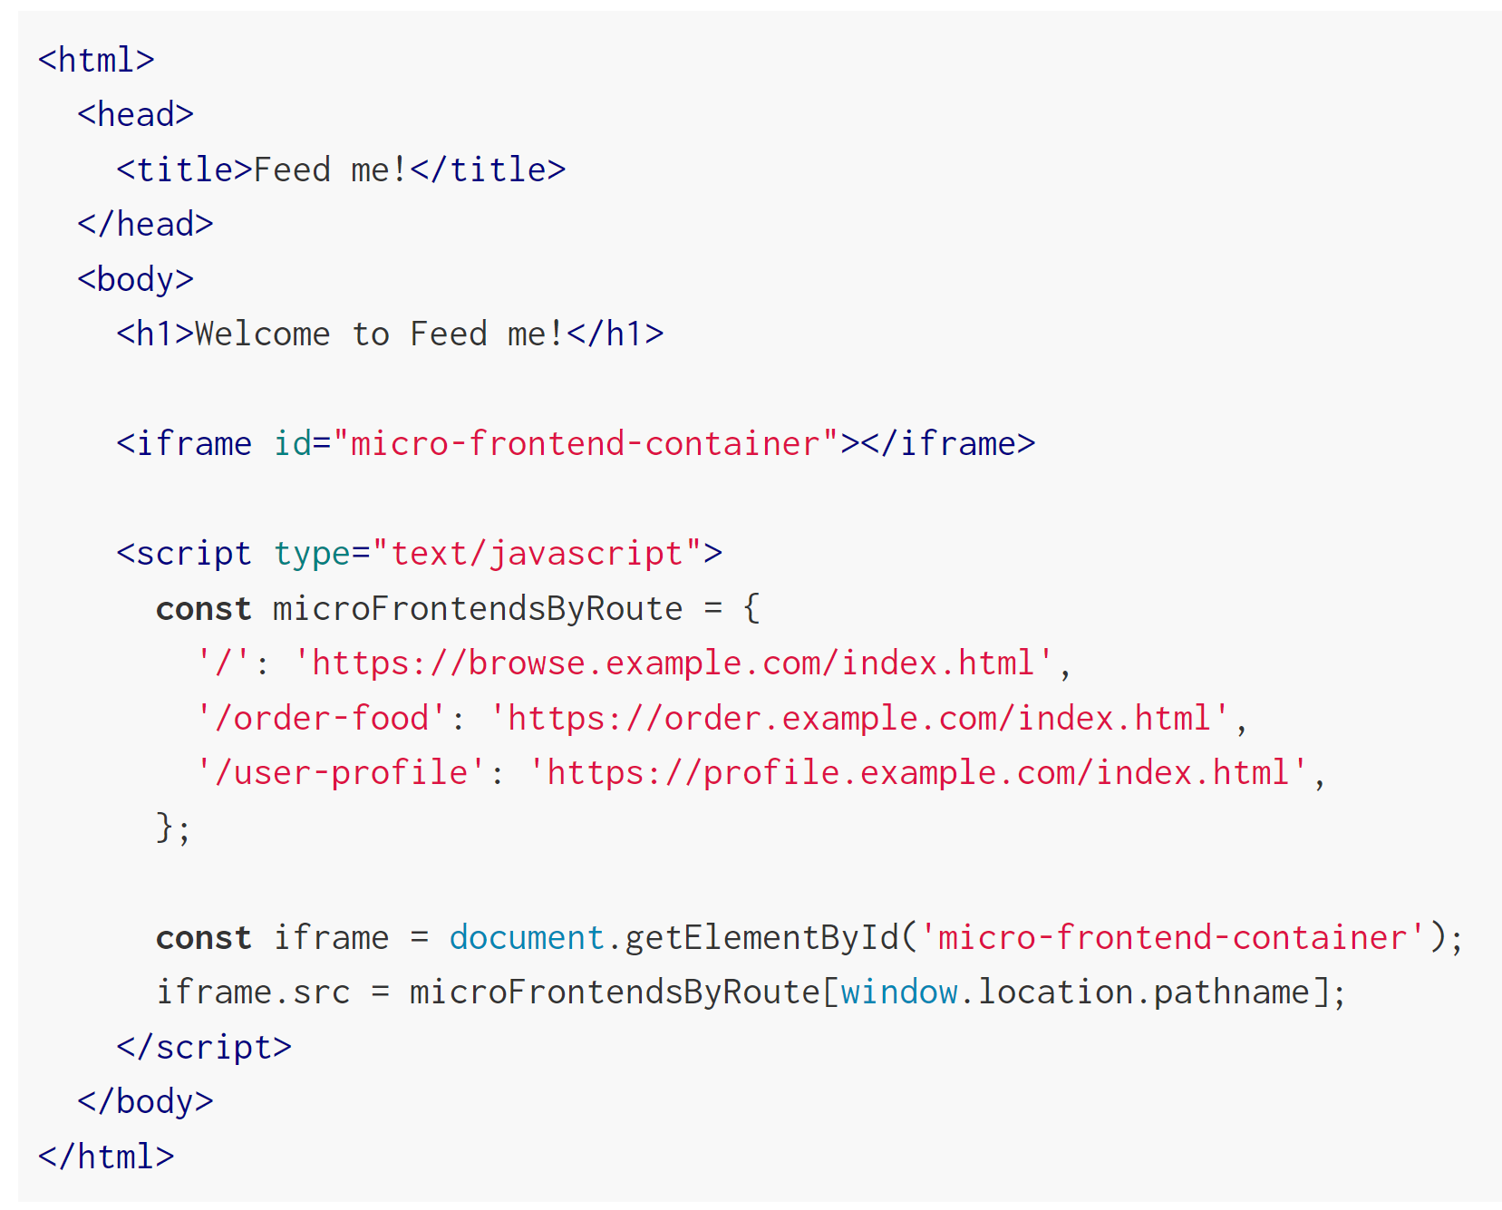
Run-time integration via iframes

Slide 15
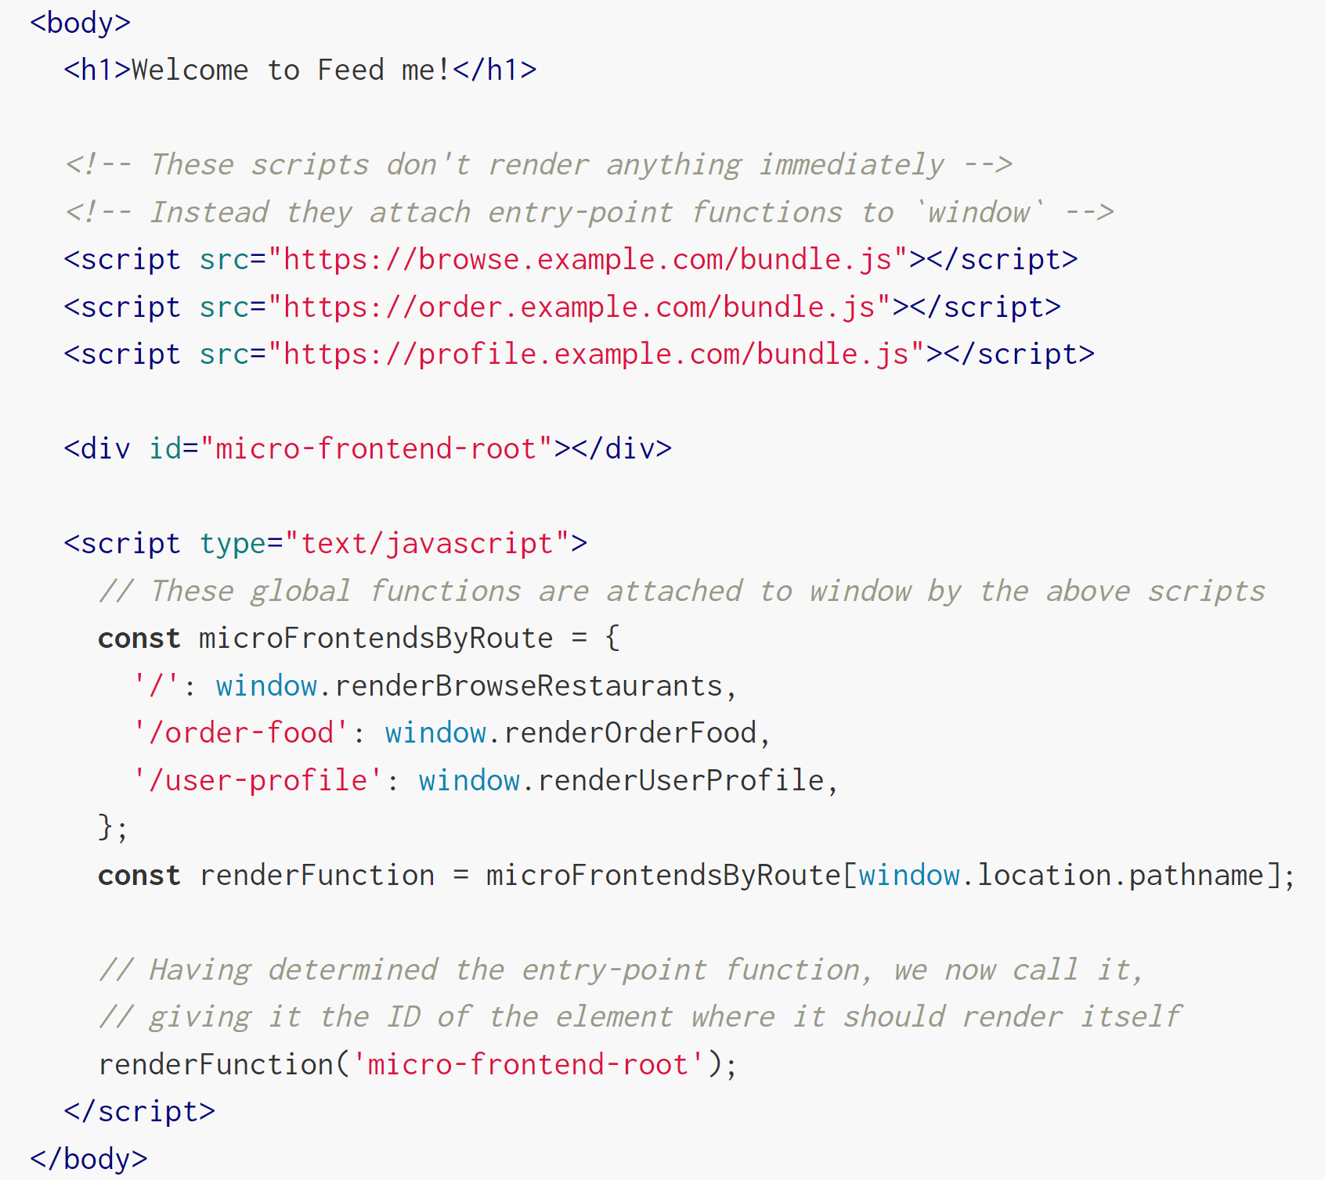
Run-time integration via JavaScript

Slide 16
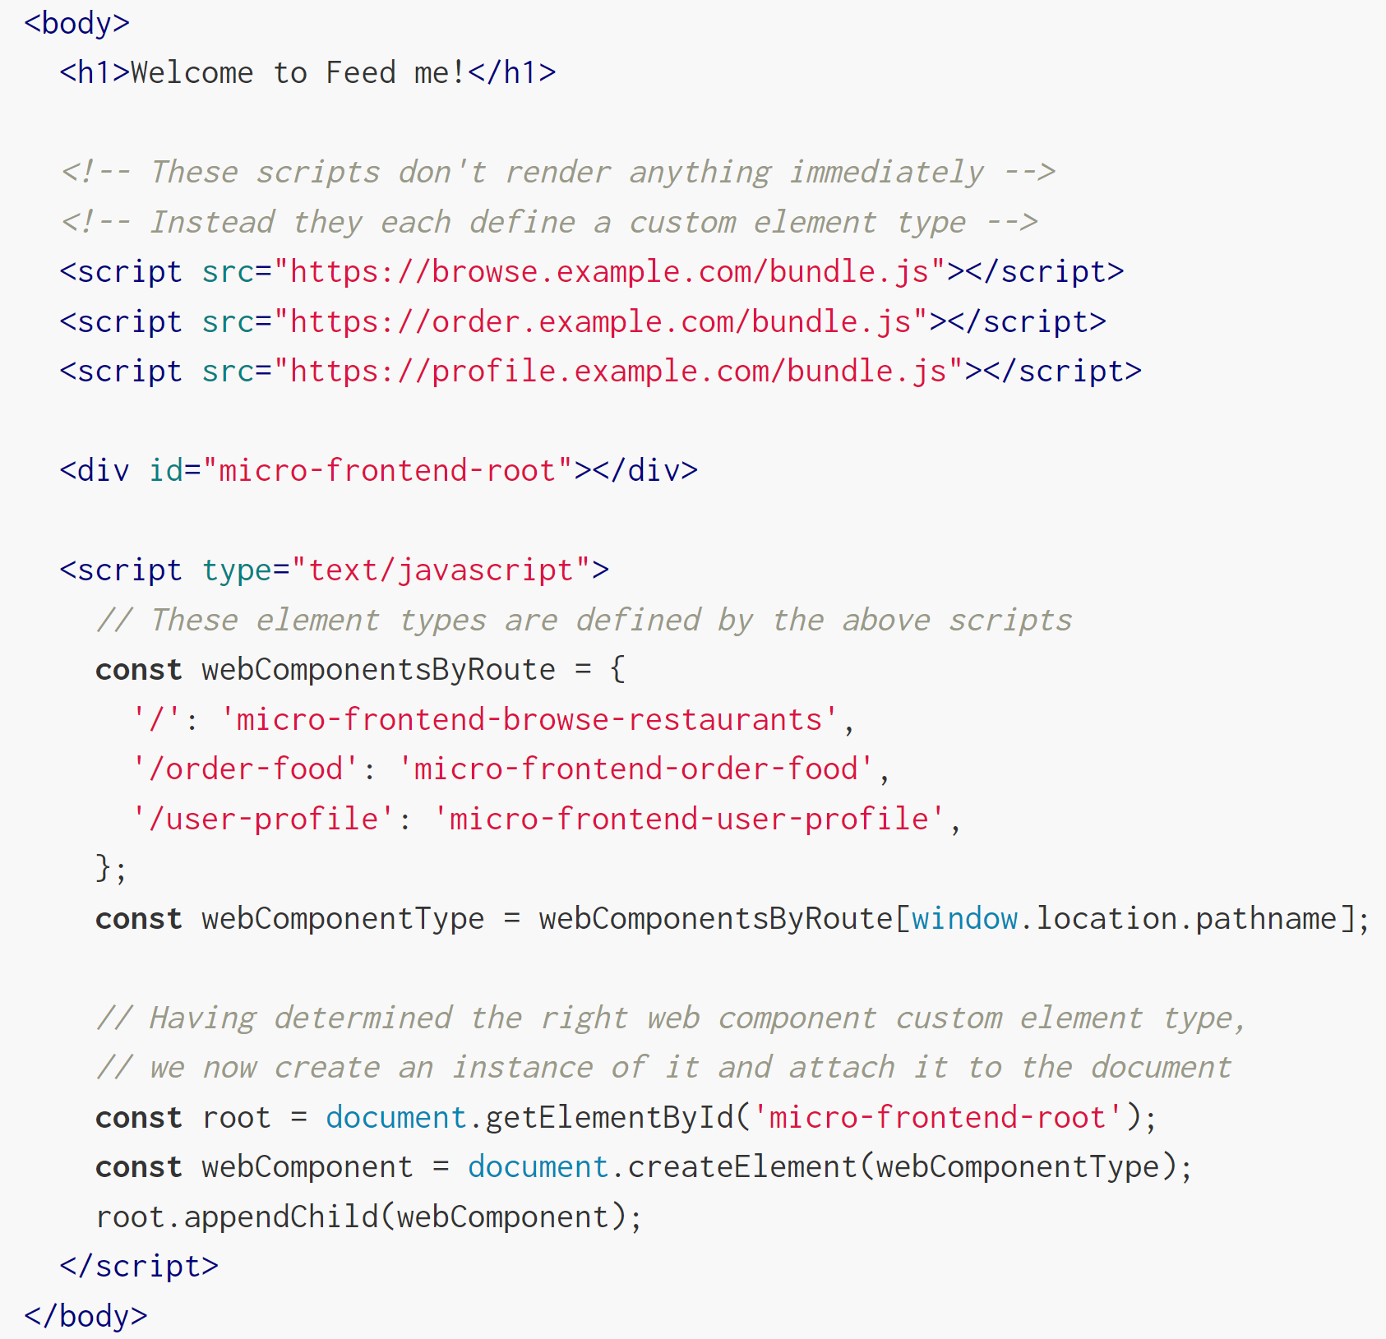
Run-time integration via Web Components

Slide 17
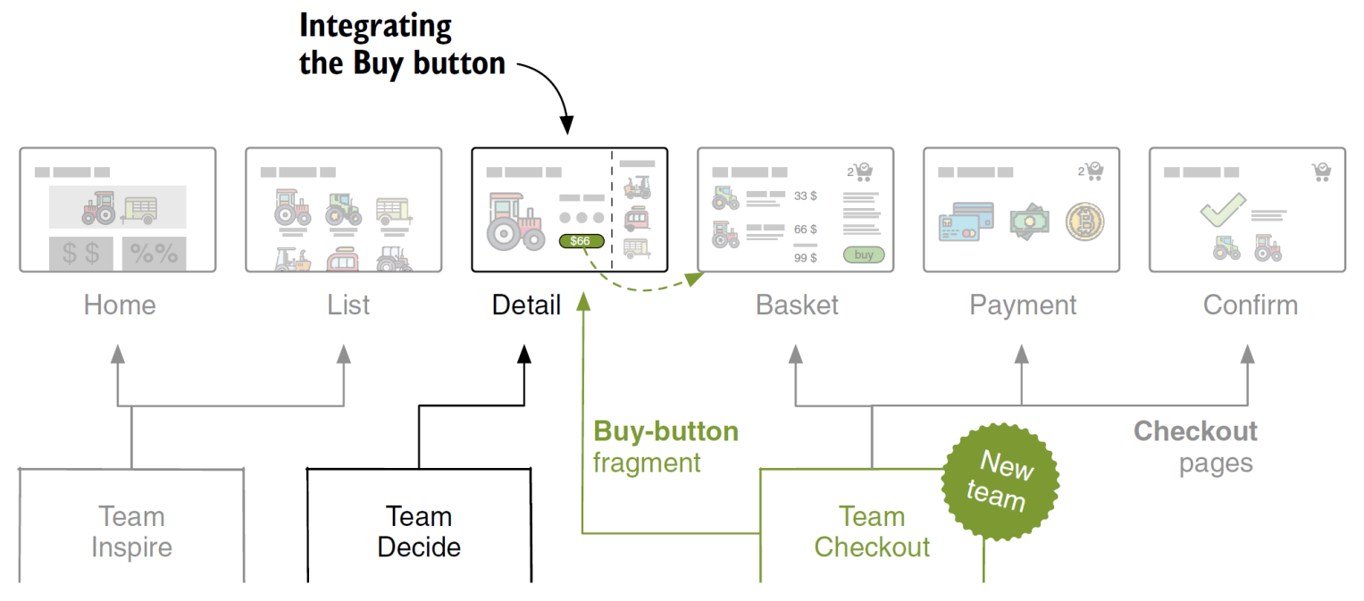
Wrapping micro frontends using Web Components [2]
Team Checkout owns the complete checkout flow.
Team Decide does not have to know about how the checkout works.
But they need to integrate Team Checkout’s Buy-button fragment in the detail page to make it work.
Team Checkout provides this button as a standalone micro frontend.

Slide 18
Styling [1]
CSS as a language is inherently global, inheriting, and cascading, traditionally with no module system, namespacing or encapsulation.
https://sass-lang.com/ (selector nesting can be used as a form of namespacing)
https://github.com/css-modules/css-modules (styles are directly applied only in the places the developer intends)
https://developer.mozilla.org/en-US/docs/Web/API/Web_components/Using_shadow_DOM (style isolation)

Slide 19
Shared component libraries
Let teams create their own components within their codebases as they need them, even if that causes some duplication initially.
Allow the patterns to emerge naturally, and once the component's API has become obvious, you can harvest the duplicate code into a shared library and be confident that you have something proven.

Slide 20
Cross-application communication
Whatever approach we choose, we want our micro frontends to communicate by sending messages or events to each other, and avoid having any shared state.

Slide 21
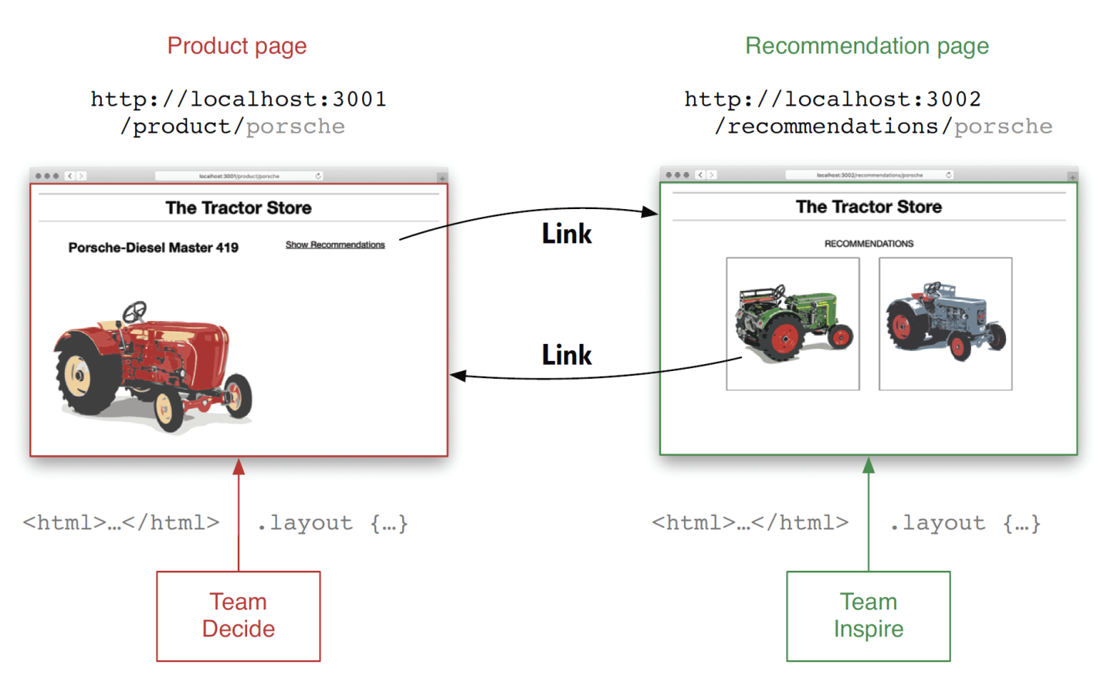
Page-to-page Communication [2]

Slide 22
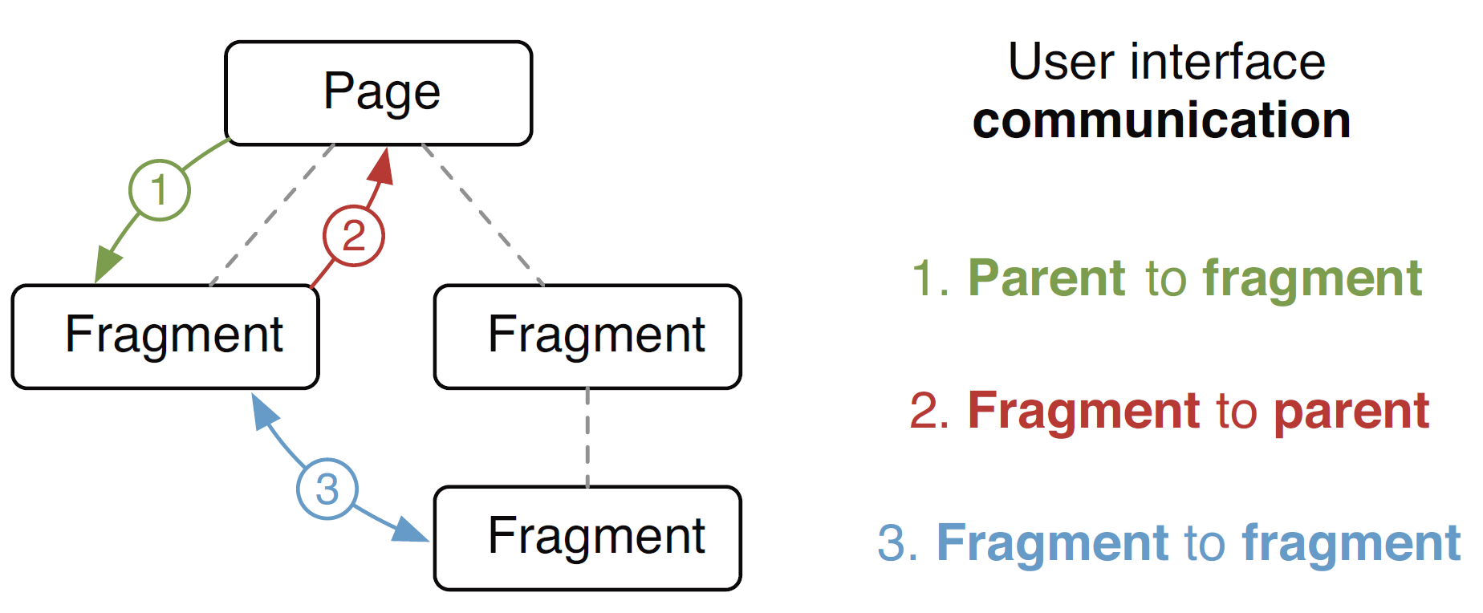
Page and Fragment Communication

Slide 23
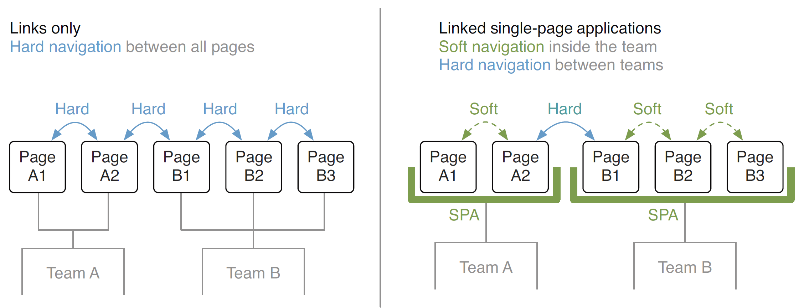
Approaches to Page Transitions

Slide 24
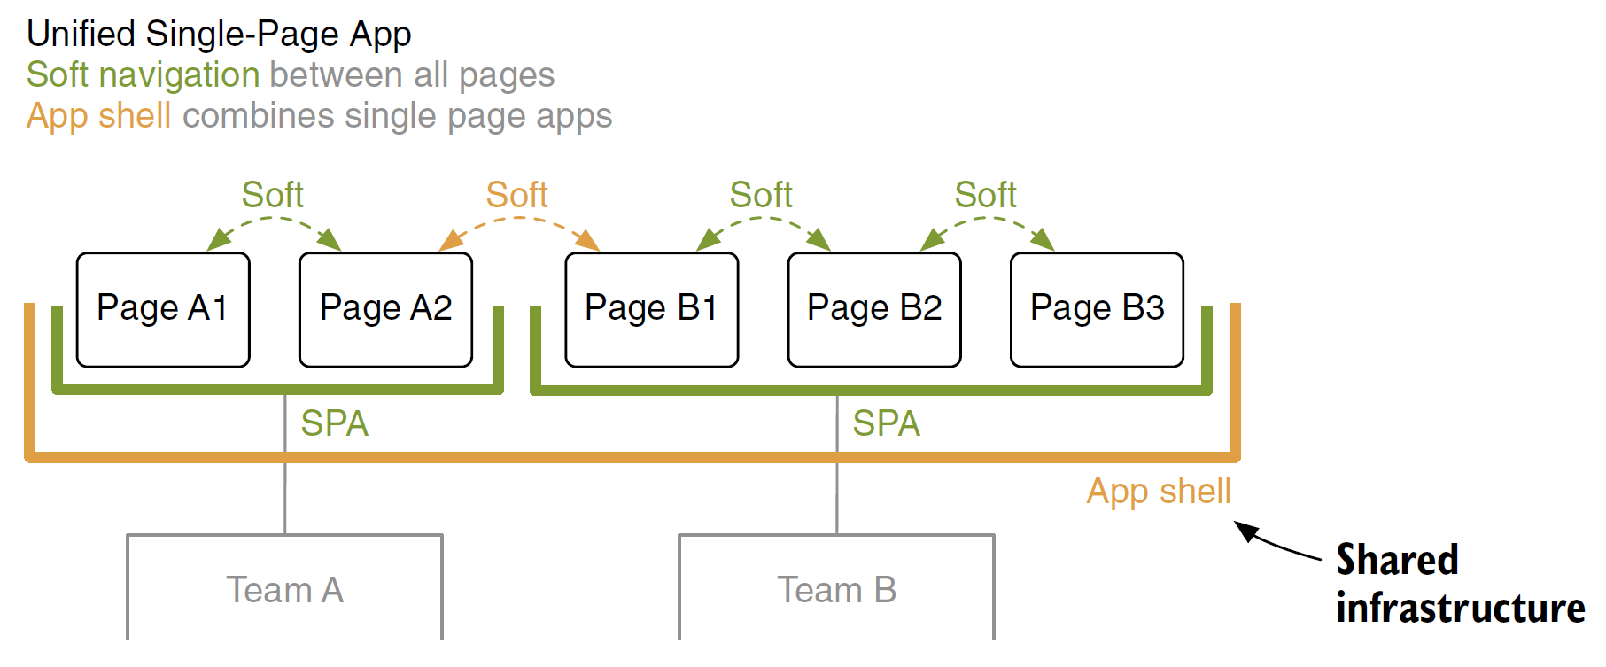
Unified Single Page App Approach
The Unified Single Page App approach introduces a central application container.
It handles page transitions between the teams.
Here all navigations are soft.

Slide 25
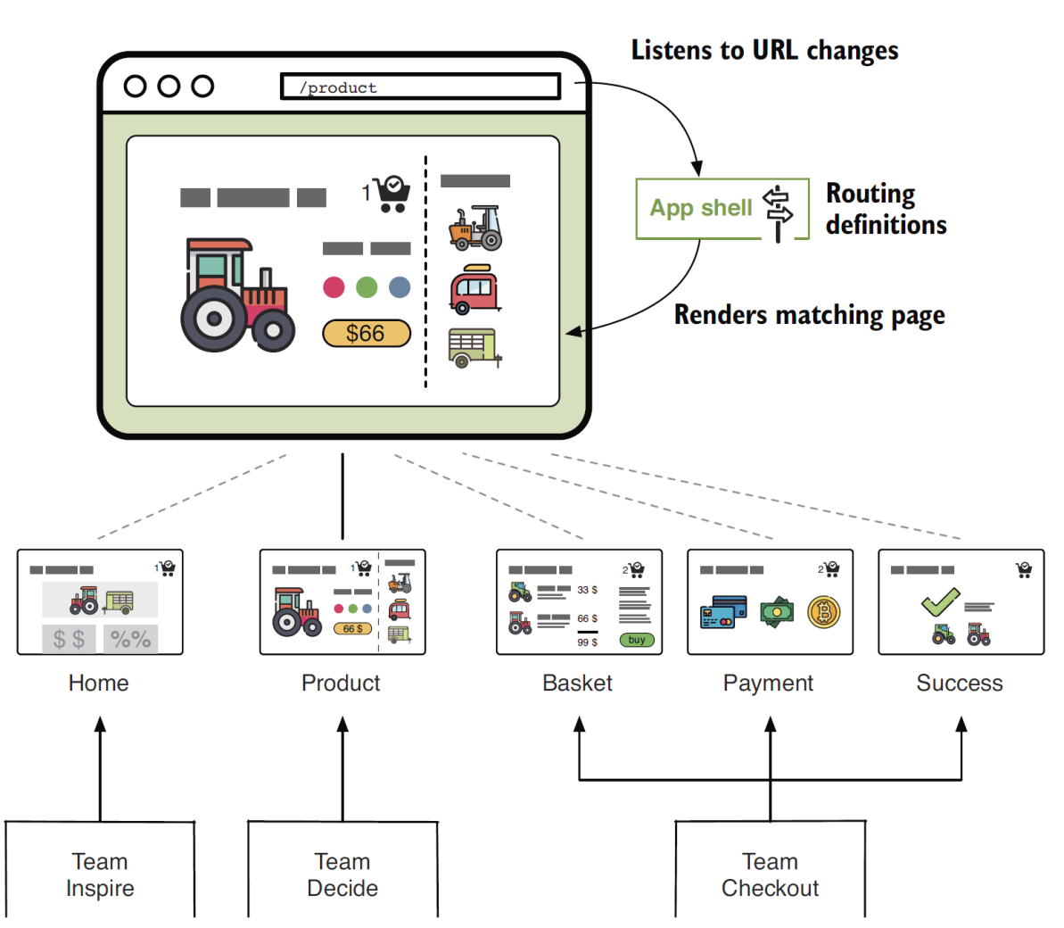
The App Shell
The app shell acts as a parent application for all micro frontends.
All incoming requests arrive there.
It selects the micro frontend the user wants to see and renders it in the <body> of the document.

Slide 26
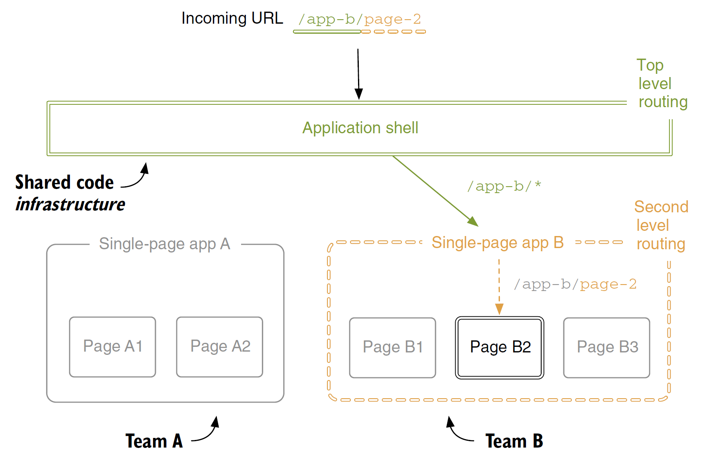
App shell with Two-level Routing
The app shell looks at the first part of the URL to determine which team is responsible (top-level routing).
The router of the matched team processes the complete URL to find the correct page inside its single-page application (second-level routing).

Slide 27
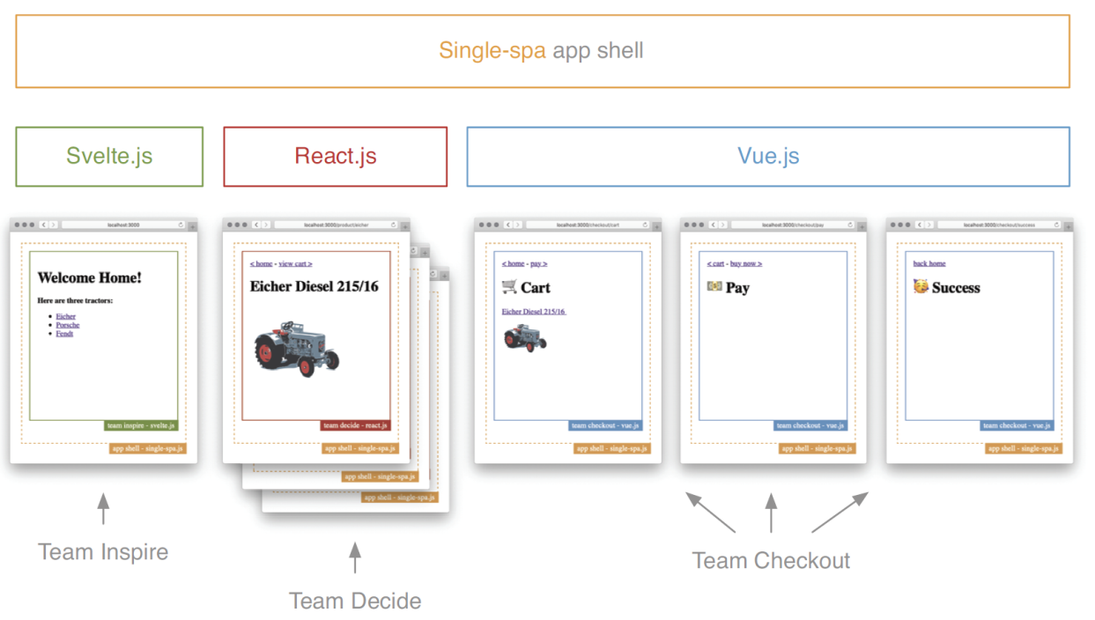
Single-SPA
https://single-spa.js.org/
Single-spa acts as the application shell which routes between the applications.

Slide 28
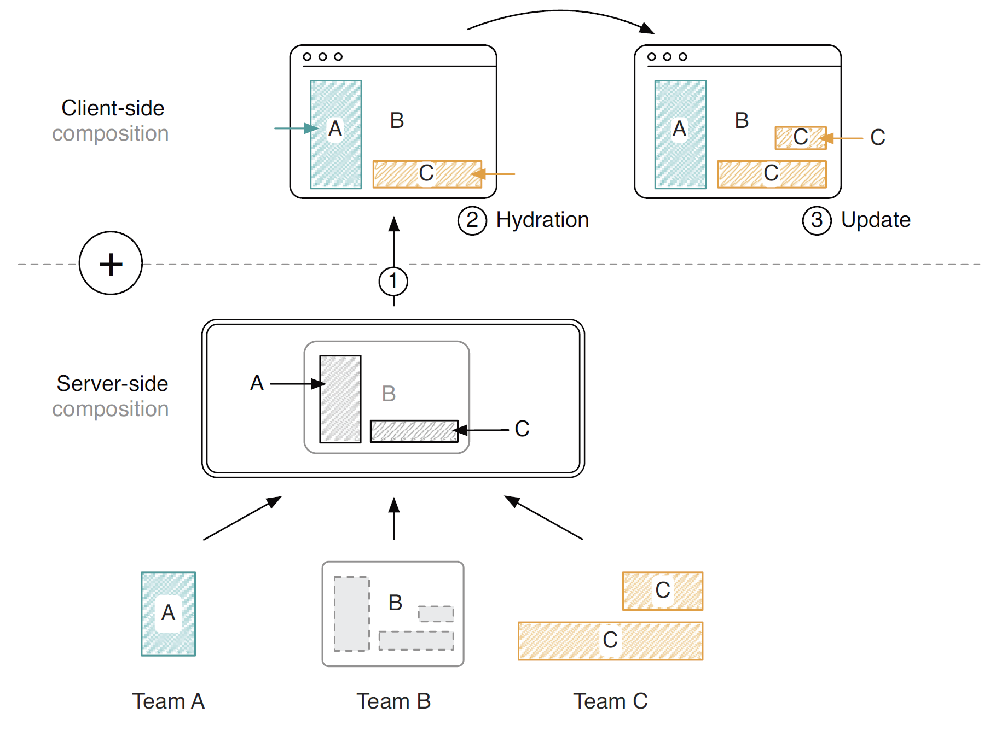
Universal Composition
The terms universal rendering, Isomorphic JavaScript, and server-side rendering (SSR) essentially refer to the same concept.

Slide 29
Universal Composition
Universal composition is the combination of a server- and a client-side composition technique.
For the first request, a technique like SSI, ESI, or Podium assembles the markup of all micro frontends server-side. The complete HTML document gets sent to the browser (1).
In the browser, each micro frontend hydrates itself and becomes interactive (2).
From there on, all user interactions can happen fully client-side. The micro frontends update the markup directly in the browser (3).

Slide 30
Tradeoffs [3]
Independently-built JavaScript bundles can cause duplication of common dependencies, increasing the number of bytes we have to send over the network to our end users.
Micro frontends will inevitably lead to having more stuff to manage - more repositories, more tools, more build/deploy pipelines, more servers, more domains.

Slide 31
Micro Frontend Demo
https://github.com/rautio/micro-frontend-demo

Slide 32


Slide 33
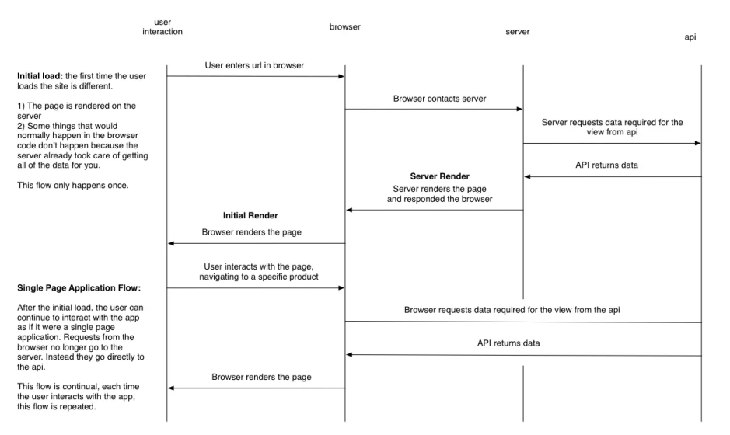
Isomorphic Applications

Slide 35
Demo 1
https://github.com/rautio/micro-frontend-demo

Slide 36
Demo 2
https://microfrontends.com/
https://github.com/orgs/micro-frontends-demo/repositories

Slide 38

Further Reading
Luca Mezzalira (2022). Building Micro-Frontends. O'Reilly Media.

Slide 39

Thank You & See You Again

